Slide 1


TRANSPORTATION

Slide 2




Our Team Members: Ganesh R (E18CSE151) Sampath Raju V (E18CSE214) Tanvi P (E18CSE187) Vamsi V (E18CSE200) Varshith K (E18CSE091) Jashwanth D (E18CSE074) Nagendra M (E18CSE097)

Slide 3
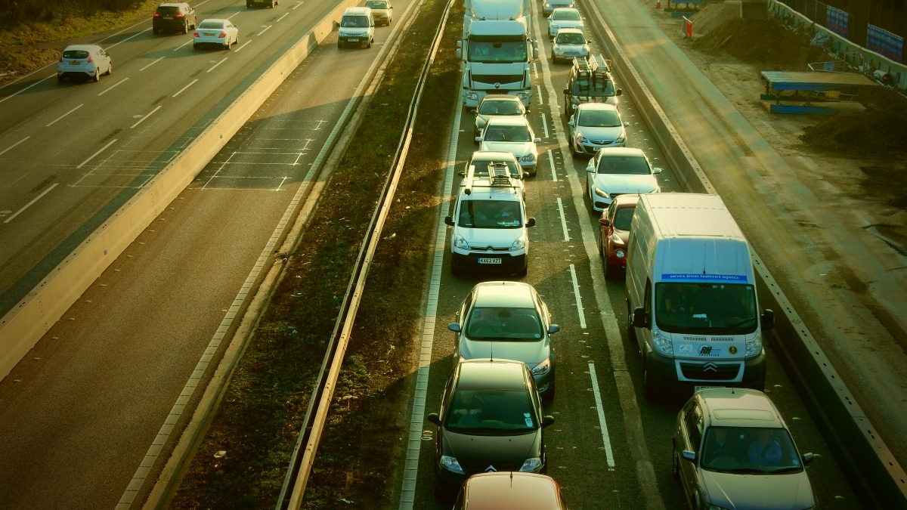
Who are we? We are the people who are responsible for moving from one place to the other.

Slide 4
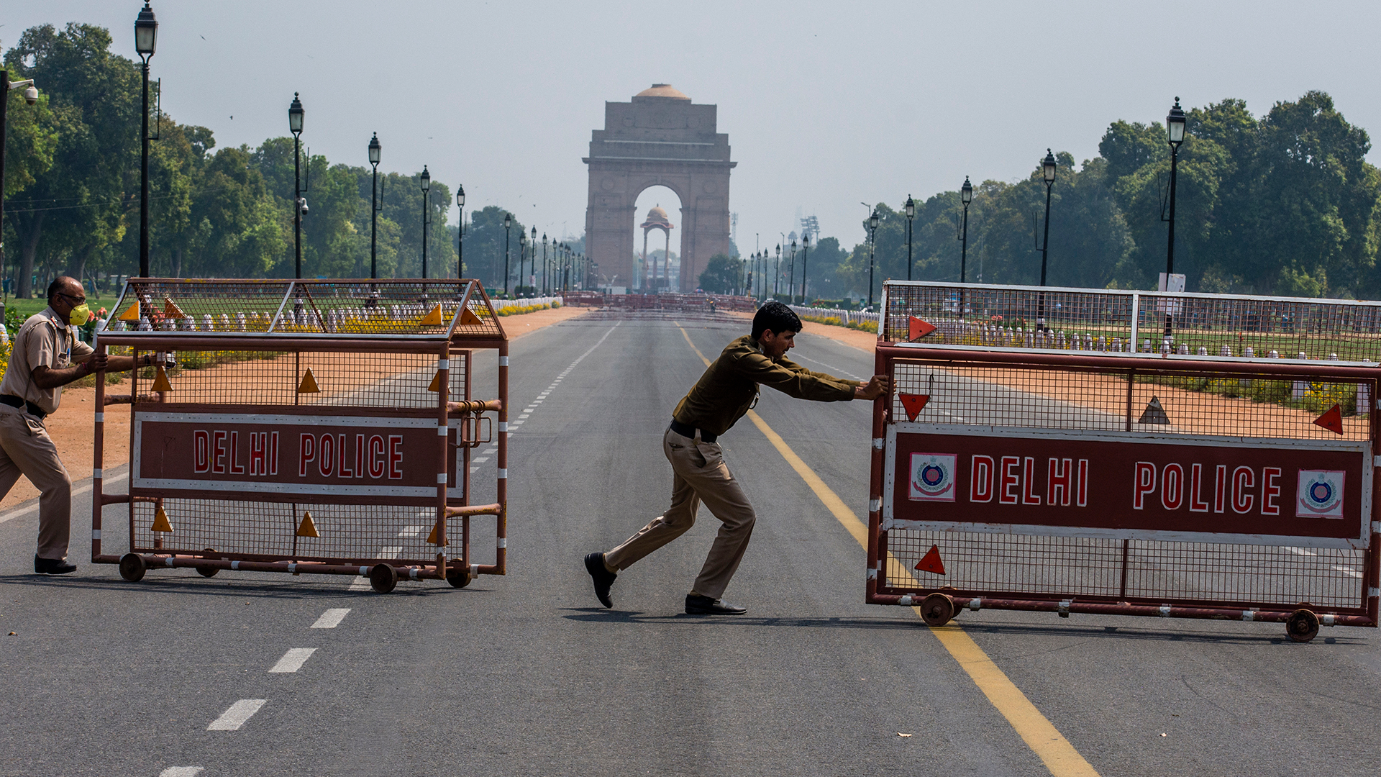
Were you in Favour of lockdown? - No our transportation sector affected a lot.
This Photo by Unknown author is licensed under CC BY-NC-ND.

Slide 5
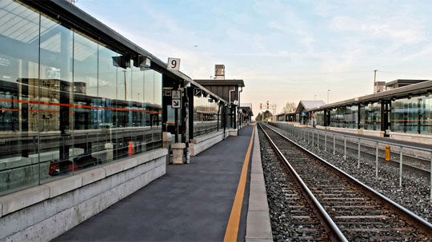
Has Lockdown affected you? --Yes, lockdown affected us.
This Photo by Unknown author is licensed under CC BY-SA-NC.

Slide 6

In what ways has lockdown affected you?
Most of the public transport, rental services companies suspended their services during the lockdown tenure.
A reduction in tourism.
A net decrease in home-to-work trips due to increased adoption of working from home.
An increase in non-shared modes of travel such as bike/scooter and a decrease in shared modes such as public transportation and ride-sharing.

Slide 7
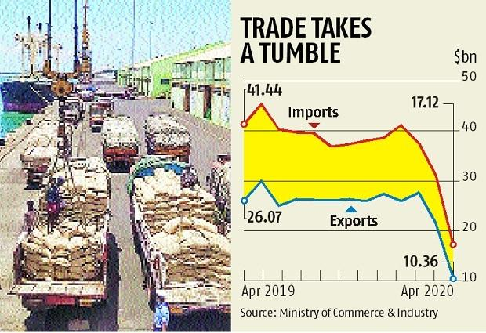
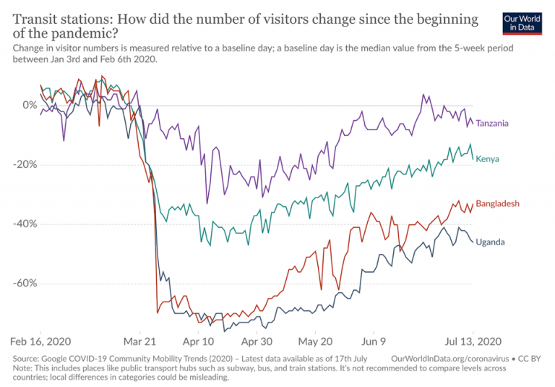
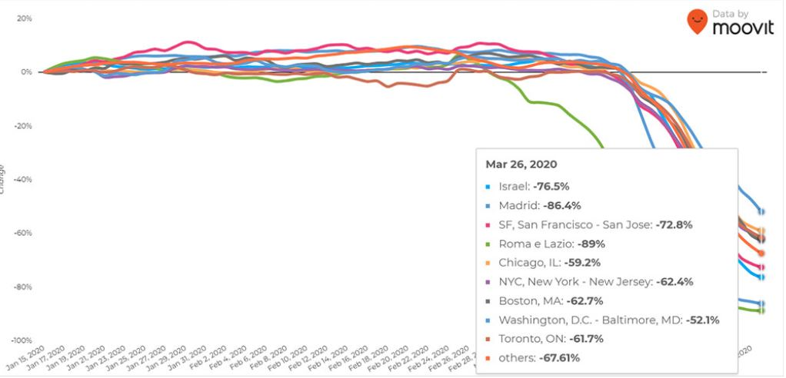
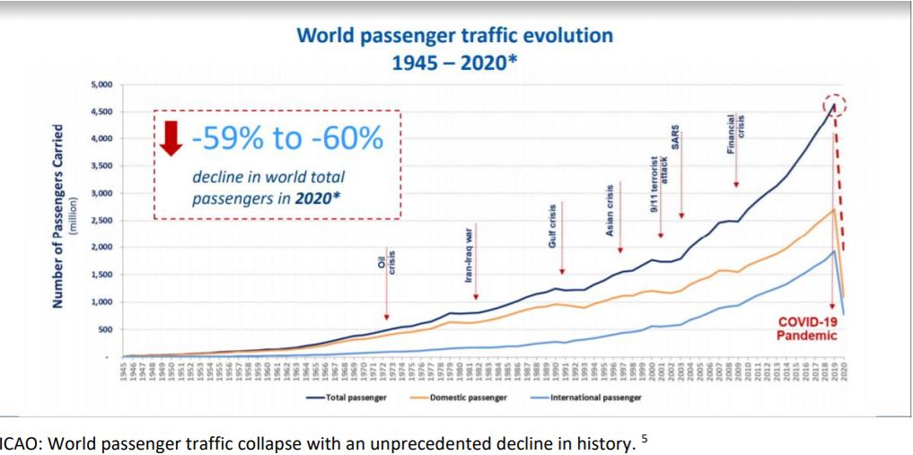

Slide 8
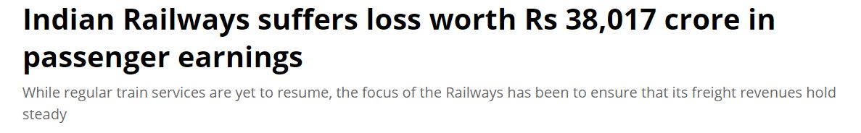
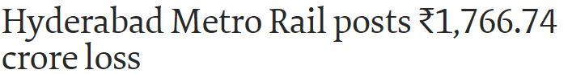
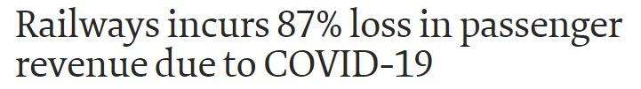
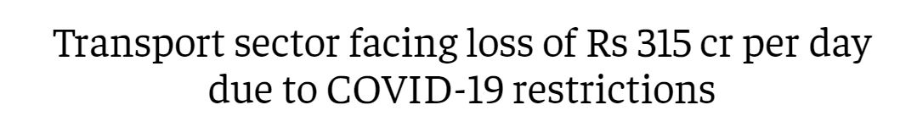
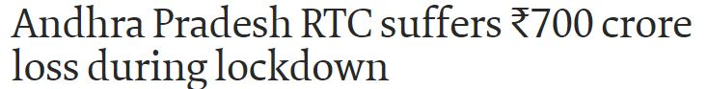
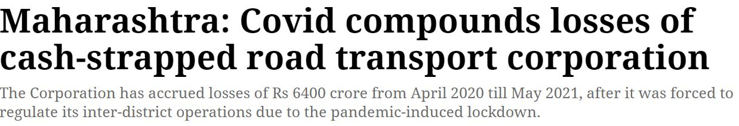
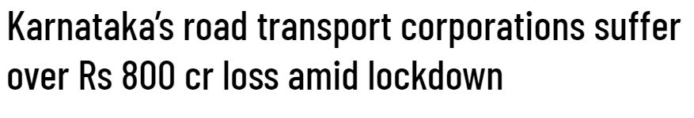
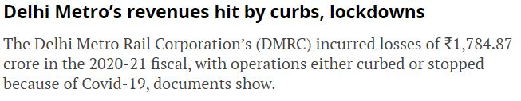
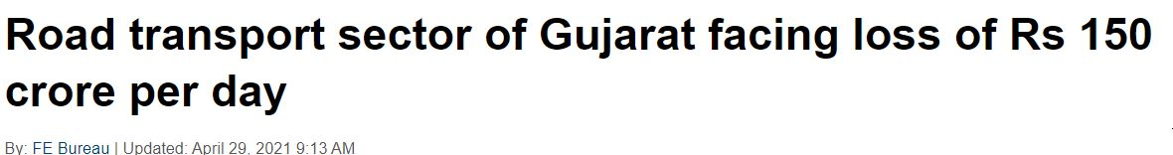
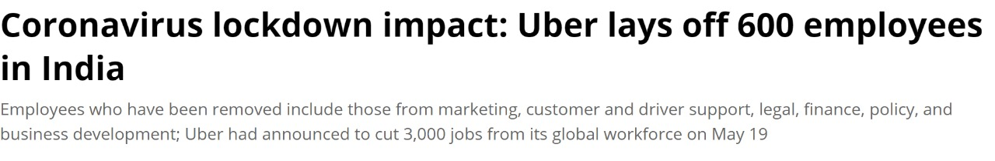
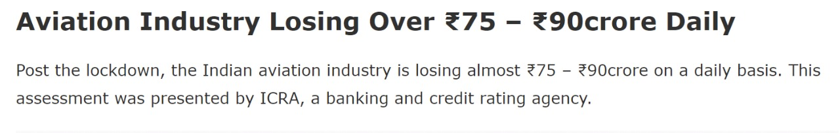

Slide 9

What is that matters most to you
Security and safety
Customer satisfaction
Time and resource management
This Photo by Unknown author is licensed under CC BY-NC.

Slide 10

This Photo by Unknown author is licensed under CC BY-SA.

